Slide 1

Long Call Timer
Team- Network Access and Core R&D
By-
Abhishek Raj Permani
MAGPIE Intern’20

Slide 2
Problem Statement
To find a threshold value of call duration, after which the call automatically gets disconnected, and to continue further the user have to redial again.
This value should satisfy the given percentage of users.
Assumptions
We have assumed that many users can simultaneously make phone calls on the network.

Slide 3
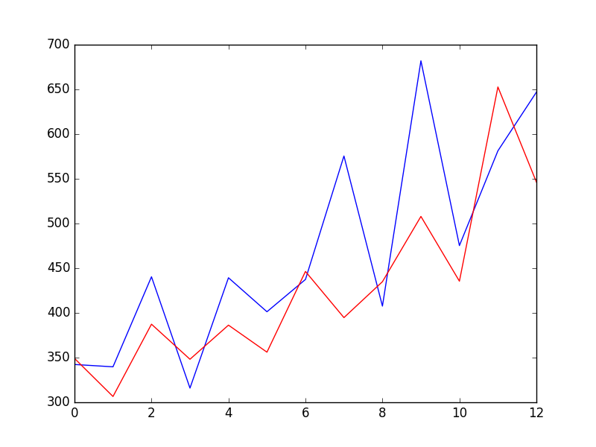
Solution Approach
Forecasting of call duration of 30 users, then calculating the threshold value needed to satisfy given percentage of users.
For forecasting the data set, ARIMA model was used .
ARIMA stands for- AutoRegressive Integrated Moving Average.

Slide 4
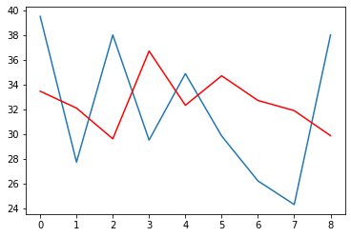
Forecast of validation data
Predicted Values
Expected values
Duration
Time
RMSE value = 15.88 minutes

Slide 5
Limitations
The Dataset is generated artificially using python, so this randomness sometimes does not guarantees the properties of time series in data set, like trend, seasonality, and others.
Conclusion
Assuming the data of 30 users for 25 days, and forecasting the call duration of each user , we obtained -
The threshold call duration value= 55.09 minutes
For satisfying 95% of users.

Slide 6
Thank You

